Slide 1
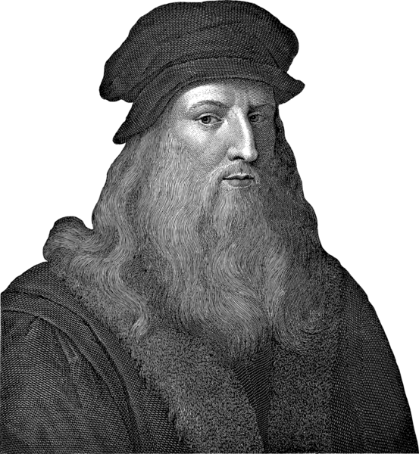
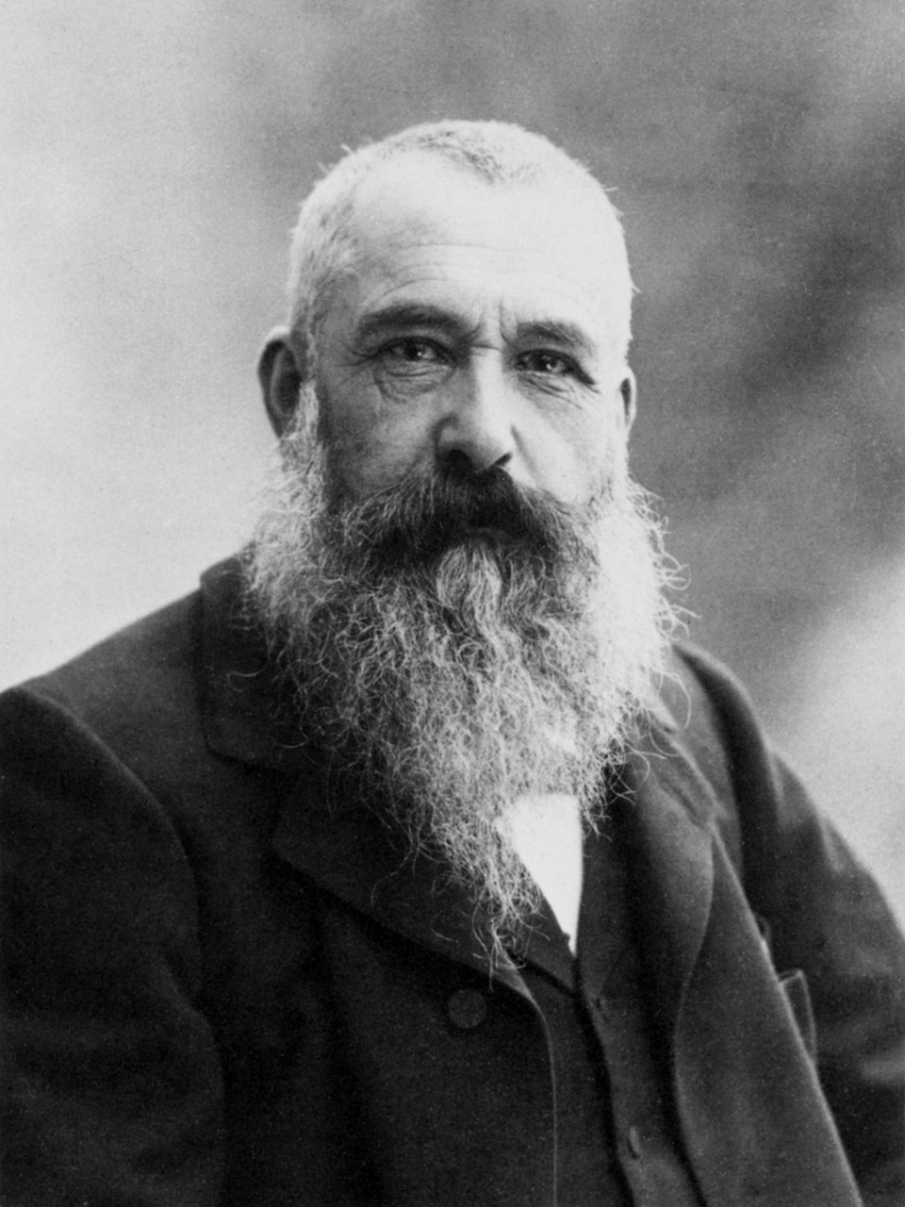
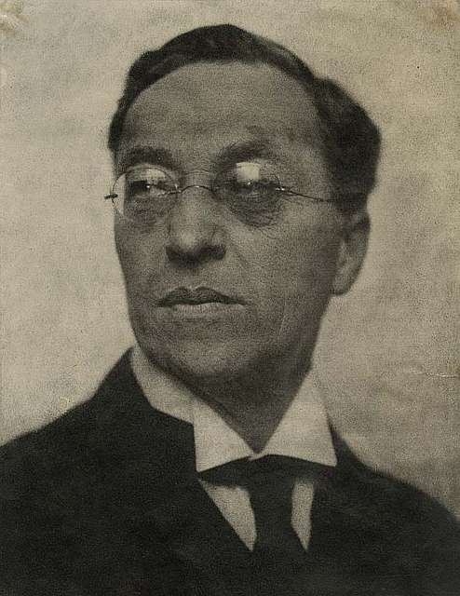
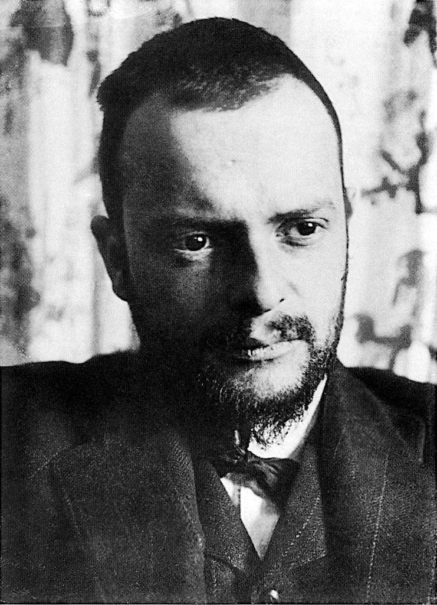
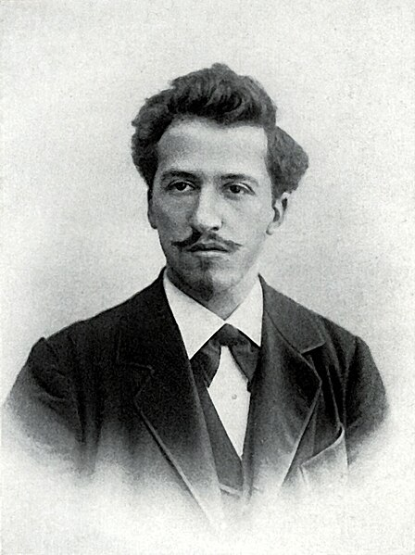
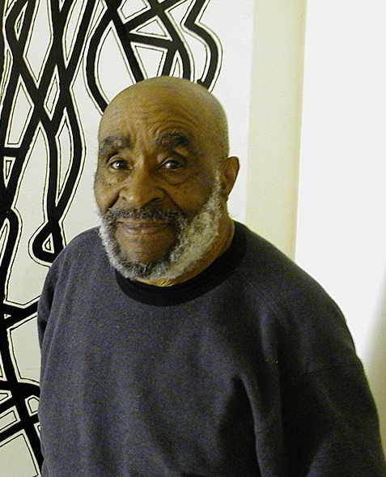
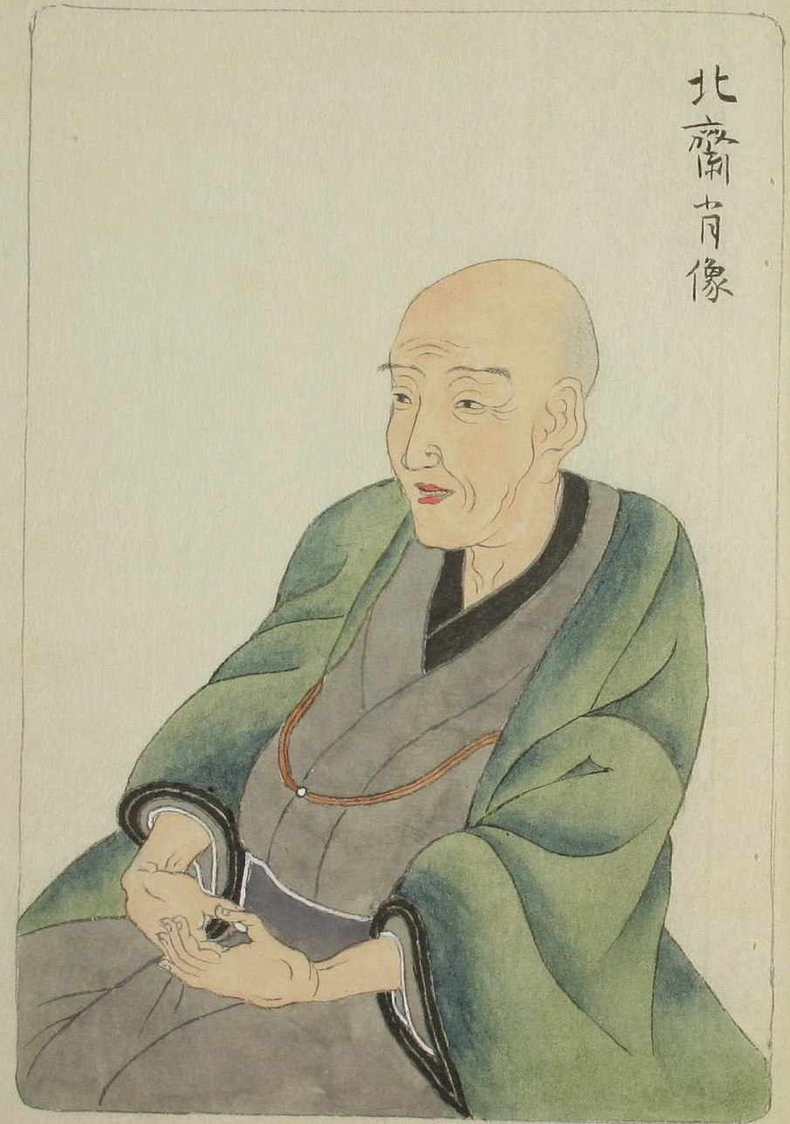
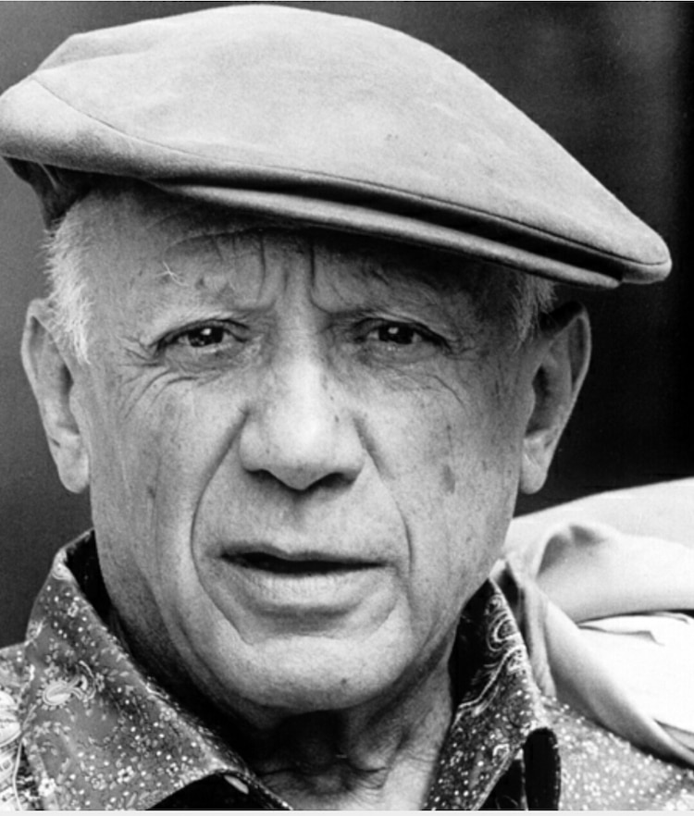
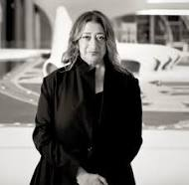
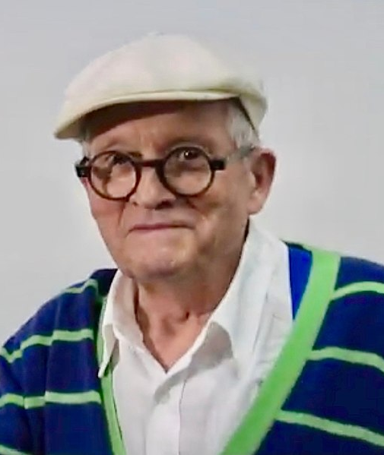
Artists in the Art & Design Curriculum
NB. The key artists in these slides will ensure that pupils can see high-quality examples of practical knowledge, as well as be exposed to artists who have made great contributions to global art, building their cultural capital. Many of the artists also allow all pupils to see themselves reflected positively in the curriculum. However, much of art history has been dominated by white men. Therefore, to ensure a diverse and inclusive curriculum, we have also included ‘hinterland’ artists – shown in grey. Their work may be less mainstream or prominent from art history perspective, but their inclusion in the curriculum ensures that all pupils have positive role models within the field of art.
Year 1
Leonardo Da Vinci
1452-1519
Claude Monet
1840-1926
Wassily Kandinsky
1866-1944
Paul Klee
1879-1940
Piet Mondrian
1872-1944
Charles McGee
1924-2021
(Frances Hatch)
Year 2
Katsushika Hokusai
1750-1849
Claude Monet
1840-1926
Pablo Picasso
1881-1973
(Boyle Family)
Active c.1960-
Zaha Hadid
1950-2016
David Hockney
1937-
(Emily Haworth-Booth)
Da Vinci - Luciaroblego, CC BY-SA 4.0, via Wikimedia Commons
McGee - Wmjuntunen (talk) (Uploads), CC BY-SA 3.0, via Wikimedia Commons
Hockney - Connaissance des Arts, CC BY 3.0, via Wikimedia Commons
Notes:
Da Vinci (CC BY-SA 4.0) - https://commons.wikimedia.org/wiki/File:Leonardo_da_vinci_retrato.png
Monet (CC0) - https://pixabay.com/fr/photos/peintre-artiste-claude-monet-62934/
Kandinsky (CC0) - https://picryl.com/media/wassily-kandinsky-1922-by-hugo-erfurth-b0aa00
Klee (CC0) - https://garystockbridge617.getarchive.net/media/paul-klee-1911-bb0bab
Mondrian (CC0) - https://commons.wikimedia.org/wiki/File:Piet_Mondriaan.jpg
McGee (CC BY-SA 3.0) cropped - https://commons.wikimedia.org/wiki/File:Charles_McGee2007.JPG
**Frances Hatch - https://www.linkedin.com/in/frances-hatch-3b099931/?originalSubdomain=uk
Hokusai (CC0) - https://commons.wikimedia.org/wiki/File:Portrait_of_Hokusai_by_Keisai_Eisen.jpg
Monet (CC0) - https://pixabay.com/fr/photos/peintre-artiste-claude-monet-62934/
Picasso (CC0) - https://freesvg.org/1542654356
**Boyle Family - https://luhringaugustine.viewingrooms.com/viewing-room/21-boyle-family-nothing-is-more-radical-than-the-facts/
Hadid (Free art licence) - https://commons.wikimedia.org/wiki/File:Zaha_Hadid_in_Heydar_Aliyev_Cultural_center_in_Baku_nov_2013.jpg
**Emily Howarth Booth - https://www.bigdrawshop.co.uk/blogs/news/interview-with-emily-haworth-booth

Slide 2
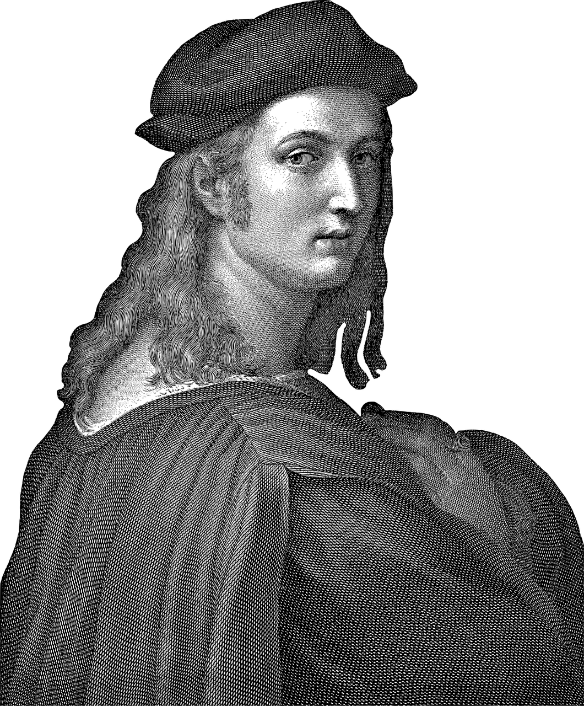
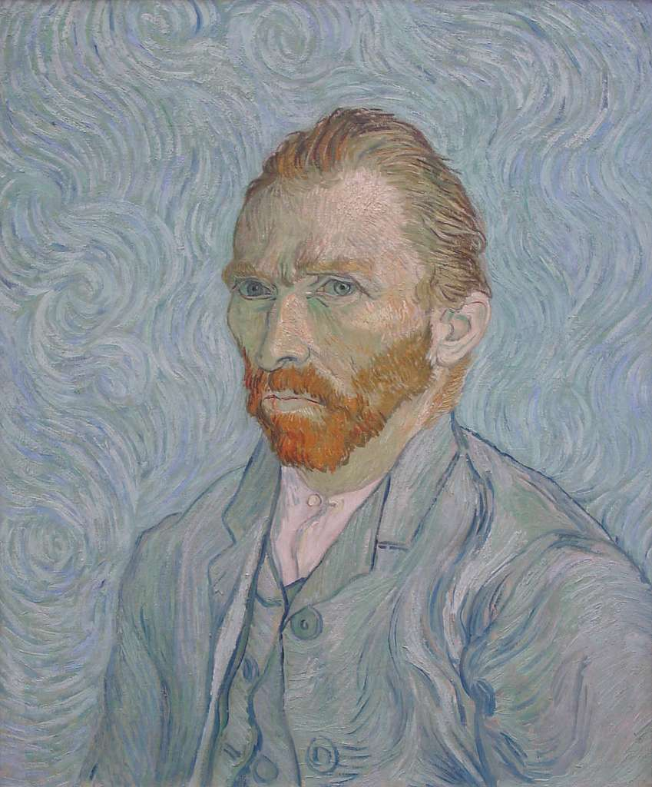
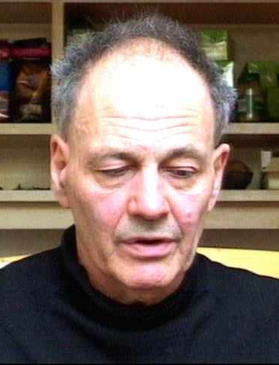
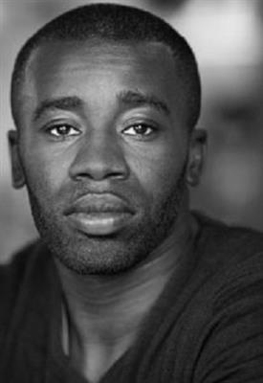
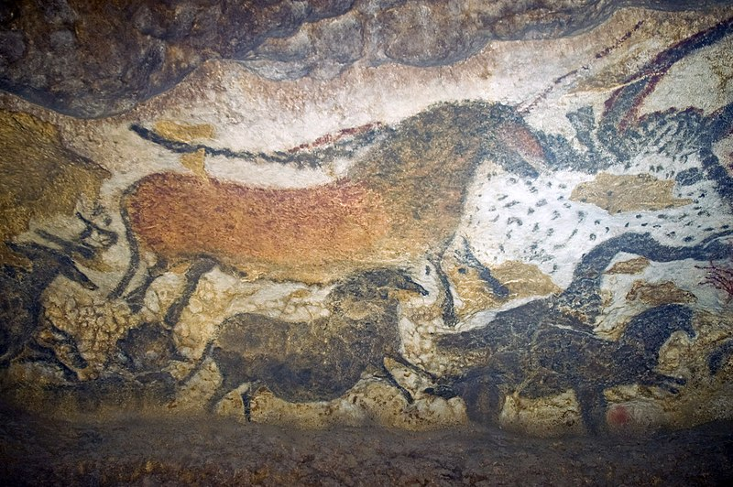
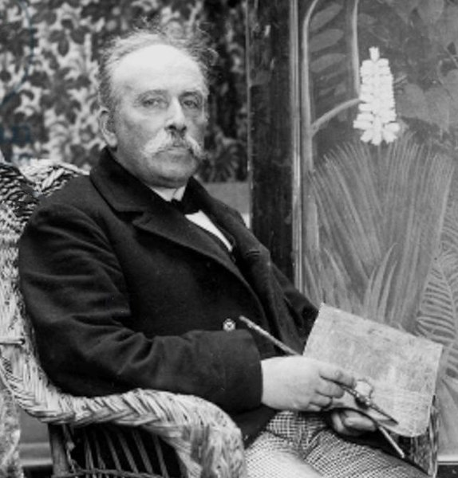
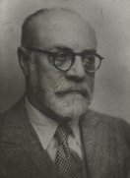
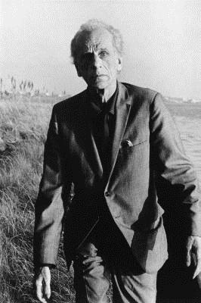
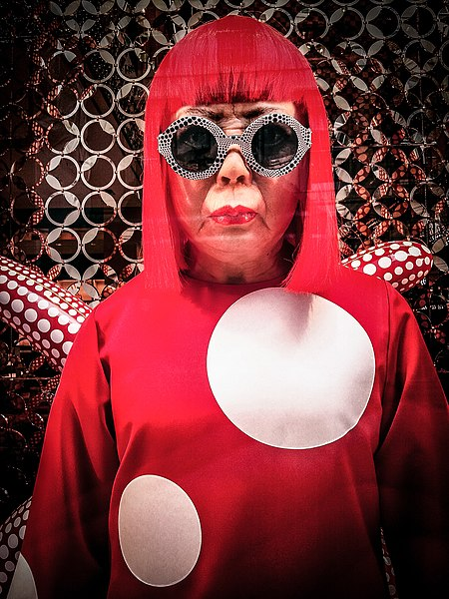

Artists in the Art & Design Curriculum
NB. The key artists in these slides will ensure that pupils can see high-quality examples of practical knowledge, as well as be exposed to artists who have made great contributions to global art, building their cultural capital. Many of the artists also allow all pupils to see themselves reflected positively in the curriculum. However, much of art history has been dominated by white men. Therefore, to ensure a diverse and inclusive curriculum, we have also included ‘hinterland’ artists – shown in grey. Their work may be less mainstream or prominent from art history perspective, but their inclusion in the curriculum ensures that all pupils have positive role models within the field of art.
Year 3
Lascaux Cave Art
17 000 – 15 000 BC
Raphael
1483-1520
Vincent Van Gogh
1833-1898
Frank Auerbach
1931-
(Quentin Blake)
1932-
(Anthony Browne)
1946-
(Satoshi Kitamura)
1937-
Chris Ofili
1968-
Year 4
Henri Rousseau
1844-1910
Henri Matisse
1869-1954
Joseph Cornell
1903-1972
Yayoi Kusama
1929-
(Abel Rodriguez)
1941-
Lascaux - Jack Versloot, CC BY 2.0, via Wikimedia Commons
Auerbach - Luke McKernan, CC BY-SA 2.0, via Wikimedia Commons
Kusama - Garry Knight, CC BY 2.0, via Wikimedia Commons
Notes:
Lascaux (CC BY 2.0) - https://commons.wikimedia.org/wiki/File:Lascaux_II.jpg
Raphael (CC0) - https://pixabay.com/fr/vectors/raphael-raffaello-sanzio-da-urbino-6539439/
Van Gogh (CC0) - https://picryl.com/media/selbstportrat-van-gogh-50d521
Frank Auerbach (CC BY-SA 2.0) - https://commons.wikimedia.org/wiki/File:Frank_Auerbach.jpg
**Chris Ofili - https://www.wikiart.org/en/chris-ofili
Rousseau (CC0) - https://commons.wikimedia.org/wiki/File:Rousseau_Joyeux_Farceurs_Dornac_crop.jpg
Matisse (CC0) - https://commons.wikimedia.org/wiki/File:Henri_Matisse_(1954).tiff
Cornell (CC) - https://en.wikipedia.org/wiki/File:Joseph_Cornell_1971.jpg
Kusama (CC BY 2.0) - https://commons.wikimedia.org/wiki/File:Yayoi_Kusama_wax_model_at_Louis_Vitton.jpg

Slide 3
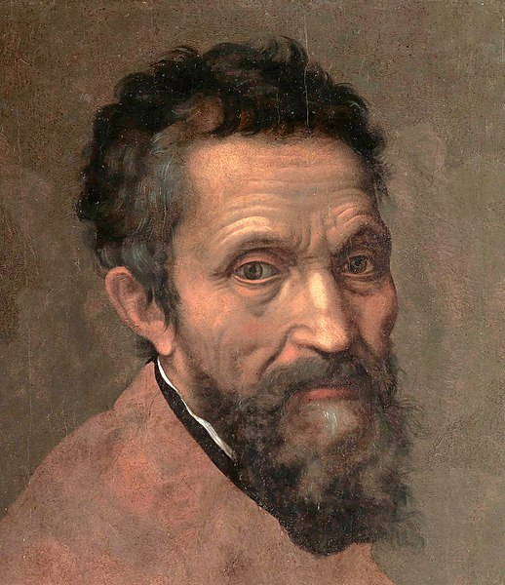
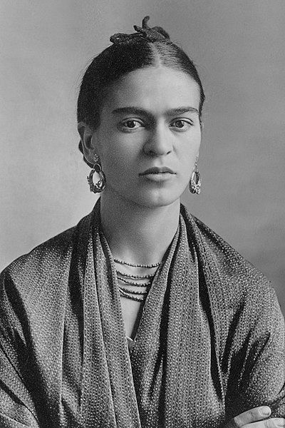
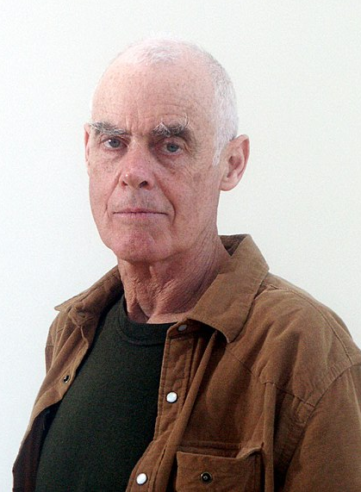
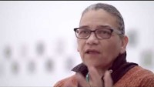
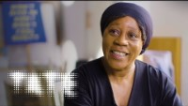
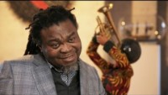
Artists in the Art & Design Curriculum
NB. The key artists in these slides will ensure that pupils can see high-quality examples of practical knowledge, as well as be exposed to artists who have made great contributions to global art, building their cultural capital. Many of the artists also allow all pupils to see themselves reflected positively in the curriculum. However, much of art history has been dominated by white men. Therefore, to ensure a diverse and inclusive curriculum, we have also included ‘hinterland’ artists – shown in grey. Their work may be less mainstream or prominent from art history perspective, but their inclusion in the curriculum ensures that all pupils have positive role models within the field of art.
Year 5
Leonardo
1452-1519
Raphael
1483-1520
Michelangelo
1475-1564
Frida
Kahlo
1907-1954
Mona Hatoum
1952-
Richard
Long
1945-
Lubaina Himid
1954-
Jackie
Morris
1961-
Marjane Satrapi
1969-
Mark
Hearld
1974-
Mel Tregonning
1983-2014
William
Grill
1990-
Year 6
Camille Pissarro
1830-1903
Kurt Schwitters
1887-1948
Judith Kerr
1923-2019
Sonia Boyce
1962-
Yinka Shonibare
1962-
Katharine Harvey
1963-
Veronika Richterová
1964-
Stephen Wiltshire
1974 -
Ifeoma Anyaeji
1981-
Serge Attukwei Clottey
1985-
Da Vinci - Luciaroblego, CC BY-SA 4.0, via Wikimedia Commons
Notes:
Leonardo (CC BY-SA 4.0) - https://commons.wikimedia.org/wiki/File:Leonardo_da_vinci_retrato.png
Raphael (CC0) - https://pixabay.com/fr/vectors/raphael-raffaello-sanzio-da-urbino-6539439/
Michelangelo (CC0) - https://commons.wikimedia.org/wiki/File:Michelangelo_Daniele_da_Volterra_(dettaglio).jpg
Kahlo (CC0) - https://commons.wikimedia.org/wiki/File:Frida_Kahlo,_by_Guillermo_Kahlo.jpg
Lubaina Himid - https://youtu.be/E0T_8JE13kU
Boyce - https://youtu.be/vRB6H06UpJ4
Shonibare - https://youtu.be/WroXoWaGfL8

Slide 4
Art & Design Practical Knowledge
Part 1 of 5
 | Formal Elements
 | Colour | Tone
N0-4 | Use colours that are representative of real objects and how I feel. | Explore mark making with different materials and using different pressure to create lighter and darker marks.
Rec
Y1 | Primary colours are red, blue and yellow. They cannot be mixed from other colours. Secondary colours are green, orange and purple. They are mixed from primary colours. | Tone is about light and dark in an artwork. A strong tone means there is a big difference (contrast) between the light and the dark areas. Doing the same thing with different materials - like pencil, fineliner, biro, felt tip - can create a different tone Shadows are an area of darkness that can be created by a sculpture or other 3D object.
Y2 | Artists can change the way a colour looks by making tints (adding white), tones (adding grey) and shades (adding black). Warm colours are red, orange and yellow. Cool colours are blue, purple and green. Colours can be used to represent emotions. For example, red can represent anger and blue can represent sadness. | Manipulate shadows using torches to create a different tone.
Y3 | Earthy colours are reds, browns, oranges (colours of earth). Tertiary colours are red-orange, yellow-orange, yellow-green, blue-green, blue-purple, red-purple. They are mixed from one primary and one secondary colour. | Tone can be created using the same pencil by pressing harder or lighter.
Y4 | vary according to the amount of each primary colour used to mix it. | Tone can be created using different grades of pencil.
Y5 | Prior knowledge of colour is explicitly reviewed in units across EYFS-KS2. | Tone can be created using white pens and pencils, which highlight areas of the artwork. Linear shading is a method of creating tone, often with a pen. Examples of linear shading include hatching, cross hatching and contoured hatching.
Y6 | Prior knowledge of colour is explicitly reviewed in units across EYFS-KS2. | Prior knowledge of tone is explicitly reviewed in units across EYFS-KS2.

Slide 5
Art & Design Practical Knowledge
Part 2 of 5
 | Formal Elements
 | Line | Form | Space | Shape
N0-4 | Make marks including lines and closed shapes. | Make 3D sculptures in junk modelling. | Implicitly create space when junk modelling. | Select items in junk modelling based on their shape.
Rec
Y1 | A line is a mark made on a surface that joins different points. Lines can vary in length, width, direction and shape. A continuous line drawing is one where the pencil does not leave the page. Doing the same thing with different materials - like pencil, crayon, pens, charcoal - can create different lines. | A form is something that you can view from all sides [it is 3D]. A form can be created as a sculpture. | Space is an area around an object. Space is created when you make a 3D sculpture (e.g. the gap between two parts of the sculpture). | Drawing can be about representing flat [2D] objects using [2D] shapes on paper.
Y2 |  |  | Space can be found around existing objects and used to create art. | Shapes can be found in existing objects and used to create art.
Y3
Y4 | Prior knowledge of line is explicitly reviewed in units across EYFS-KS2. | A form can be represented using tone in a 2D artwork |  | Drawing can be about representing 3D forms with 2D shapes on paper (a 2D surface).
Y5 |  | Prior knowledge of form is explicitly reviewed in units across EYFS-KS2.
Y6 |  | Prior knowledge of form is explicitly reviewed in units across EYFS-KS2. | Prior knowledge of space is explicitly reviewed in units across EYFS-KS2. | Prior knowledge of shape is explicitly reviewed in units across EYFS-KS2.

Slide 6
Art & Design Practical Knowledge
Part 3 of 5
 | Formal Elements
 | Pattern | Texture
N0-4 | Create patterns when making marks. Describe patterns. | Describe how materials feel using words like rough and smooth.
Rec
Y1 | Patterns can be created with a series of repeated marks like dots and lines.
Y2 | Identify patterns in the world around us. | Texture is how something feels. Artists can make art that tells us how something might feel, without us having to touch it.
Y3
Y4
Y5
Y6 | Prior knowledge of pattern is explicitly reviewed in units across EYFS-KS2. | Prior knowledge of texture is explicitly reviewed in units across EYFS-KS2.

Slide 7
Art & Design Practical Knowledge
Part 4 of 5
 | Control of Materials
 | Printing | Sculpture | Digital | Mixed Media
EYFS | Make simple prints using poster paints. | Explore making sculptures using a range of materials and junk modelling
Y1 | Press print onto paper or fabric using the natural colour of the leaves. | Create a paper sculpture by folding and twisting and gluing it together.
Y2 | Using crayons to transfer texture and pattern from existing surfaces. Monoprint onto paper. Create a plate to make a press print. Apply ink (or paint) with a roller. Press print onto paper or fabric using a plate. |  | Take photographs of objects and surfaces using cameras or tablets | Create a collage.
Y3 |  | Make a tile using clay. Make a raised relief by adding layers of clay. Use slip (a mixture of clay and water) as a glue in ceramics. Score surfaces before adding slip to help the pieces attach more reliably. | Take photographs of tableau vivant, which is made by standing still to represent the figures in a story. | Create a montage
Y4 | Collagraphic printmaking is a process in which materials are built up on a plate to be printed from. | Arrange a 3D composition by considering size, shape, texture and space between objects
Y5 | Prior knowledge of printing is explicitly reviewed. | Origami is a Japanese artform of creating 3D models by folding a piece of paper. | Design figures and characters in software programmes (e.g. PowerPoint).
Y6 |  | Cut, shape and manipulate existing objects to create a sculpture. |  | Prior knowledge of mixed media is explicitly reviewed in units across EYFS-KS2.

Slide 8
Art & Design Practical Knowledge
Part 5 of 5
 | Control of Materials
 | Mark Making | Painting | Drawing
EYFS | Use mark-making tools with a palmer grasp or digital pronate grasp. Use mark-making tools with a static tripod grip. Use mark-making tools with a dynamic tripod grip. | Explore mark making with paints with increasing confidence and skill. | Make marks to draw familiar things.
Y1 | Focus on pencils and paintbrushes Focus on pens and pencils. Focus on wax crayons Focus on pens. | Use poster paints. Use wax resist technique with watercolour paints. Mix colours using watercolour paints on the page (not in a palette). Use a flat wash brushstroke with watercolour paint. | Making simple line drawings, including continuous line drawings.
Y2 | Focus on using crayons on their side to create rubbings. | Mix colours using poster paints in a palette. Use stippling, tapered and dry brushstrokes with watercolour paint. Use wet on wet and 'less to more see through' [opaque to translucent] techniques. Use different amounts of water to create stronger [more opaque] and weaker [more translucent] colours. Different paintbrushes are suited to different brush strokes and techniques.
Y3 | Focus on chalk pastels. | Mix colours using acrylics paints in a palette. | When drawing from observation artists must look often and very carefully and at the object they're drawing from.
Y4 |  | Prior knowledge of painting is explicitly reviewed in units across EYFS-KS2. | Make a tonal drawing using pencil.
Y5 |  |  | When drawing from primary observation, artists look at the object they're drawing from. When drawing from secondary observation, artists look at a drawing or a copy of object.
Y6 |  |  | Draw the human face and its features in proportion using pencil.

Slide 9
Progression in Theoretical Knowledge
Different Artworks
EYFS | Illustrations are the pictures in a book that tell a story. Different artists make art in different ways.
Y1 | Abstract art is art that does not try to look like things in the real world. Instead, it is made up of shapes, colors, and lines that might not look like anything you recognize. Representational art tries to look like things in the real world, such as people, animals, or objects. When you look at representational art, you can usually tell what it is supposed to be. Art can be flat [2D] or something that you look around [3D]. A sculpture is an artwork can be viewed from all sides [it is 3D]. A sculptor is an artist who makes sculptures.
Y2 | Illustrations help to tell a story. Artists who make illustrations are called illustrators. A collage is an artwork made by sticking pieces of paper or other materials onto a background.
Y3 | Mixed-media is artwork that uses more than one art material e.g., paint and pens. Ceramics is the process of making art from clay. A montage is a mixed-media artwork including collaged photographs. Traditional art describes everything from early Christian art to the 1850s and is usually representational. Modern art describes art made from around the 1850s to the 1970s. Modern artists wanted their art to show how they felt. It was more abstract than representational. Contemporary art describes artwork being made by living artists, or art that has been made recently (e.g., 1980s onwards). Contemporary art can be anything and artists create work using traditional, modern and other techniques. Traditional, modern and contemporary art definitions can only be applied to western art. Artists can arrange objects or images in a composition. Traditional composition is often made up of foreground, midground and background. Perspective is the way a flat (2D) image looks deep (3D). Illustrations help to tell a story. Narrative art tells a story on its own.
Y4 | A viewfinder can be used to identify an interesting section within a composition. An assemblage is a 3D artwork usually made of found objects. A still life is a genre of artwork that shows a collection of objects.
Y5 | Artwork does not have to be abstract or representational. It is a spectrum. Some artworks are representational (so you can recognise the objects from the real world), but they don't look realistic. Expressive art conveys emotions and feelings. There are more examples of expressive art in modern and contemporary than traditional art. Expressive art can be representational or abstract.
Y6 | Installation art is designed to fill a specific space, often for a particular length of time. An exhibition is a display of artwork. It is curated by a curator.

Slide 10
Progression in Theoretical Knowledge
Traditional, Modern and Contemporary Artists
Klee
(1910-40s) – Y1
Mondrian
(1910-40s) – Y1
Kandinsky
(1910s-20s) – Y1
Hockney
(1960-2020s) – Y2
Auerbach
(1960-2020s) – Y3
Long
(1960-2020s) – Y5
Rousseau
(1750-1780s) – Y4
Hokusai*
(1820-30s) – Y2
Van Gogh
(1880-90s) – Y3
Matisse
(1940-50s) – Y4
Himid
(1980-2020s) – Y5
1490
1500
1520
1520
1750
1760
1770
1780
1790
1800
1810
1820
1830
1840
1850
1860
1870
1880
1890
1900
1910
1920
1930
1940
1950
1960
1970
1980
1990
2000
2010
2020
2030
Leonardo (1470s-1500s) – Y1
Raphael (1500s-1520) – Y3
Michelangelo (1500s-40s) – Y5
Monet
(1860-1900s) – Y1
McGee
(1950-2020s) – Y1
Kusuma
(1950-2020s) – Y1
Hadid
(1990-2010s) – Y2
Ofili
(1990-2020s) – Y3
Boyce
(1990-2020s) – Y6
Shonibare
(1990-2020s) – Y6
Picasso
(1900-50s) – Y2
Kahlo
(1930-40s) – Y5
*The art history terms traditional, modern and contemporary art are only applied to western art.

Slide 11
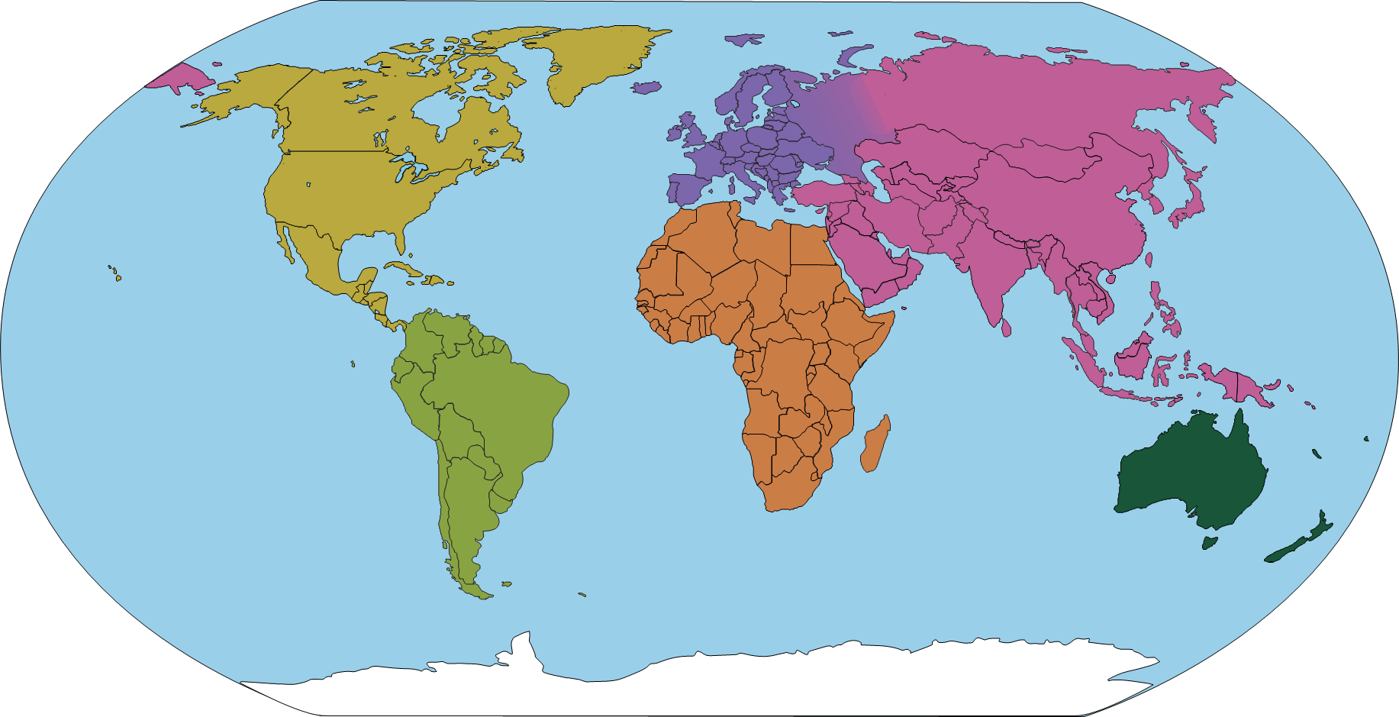
Progression in Theoretical Knowledge
Artists from around the world
UK
Hockney (Y2)
Ofili (Y3)
Long (Y5)
Himid (Y5)
Boyce (Y6)
France
Monet (Y1)
Rousseau (Y4)
Matisse (Y4)
Netherlands
Mondrian (Y1)
Van Gogh (Y3)
Italy
Raphael, Michelangelo, Leonardo (Y1, Y3)
Russia
Kandinsky (Y1)
Germany
Klee (Y1)
Auerbach (German-British) (Y3)
USA
McGee (Y1)
Spain
Picasso (Y2)
Japan
Hokusai (Y2)
Kusama (Y4)
Mexico
Kahlo (Y5)
Iraq
Hadid (British-Iraqi) (Y2)
Colombia
Rodriguez (Y4)
Nigeria
Anyaeji (Nigerian) Y6
Shonibare (British-Nigerian) (Y6)

Slide 12
Progression in Disciplinary Knowledge
 | What do artists do? | What inspires artists? | Understanding Artworks
EYFS | Artists explore and play. | Artists can be inspired by the stories they read. | Make statements about my artwork.
Y1 | Artists experiment, explore and play. A sketchbook is a special book that artists use. | Artists can be inspired by the natural world. | Review the above. Discuss the work of artists, including our own.
Y2 | Review the above. Artists often create art for its own sake. Designers create things that are useful and have a purpose. Sometimes artists are designers who create art for a specific purpose. Architects are artists and designers who design buildings. Art can be made by individual artists, or by a group of artists who collaborate. | Review the above. Artists can be inspired by hidden details in seemingly ordinary objects. Artists can be inspired by the artificial (man-made) world. | Review the above. Label the features of different artworks with key words.
Y3 | Review the above. Creating art is something humans have done from the very beginnings of their existence. Artists make choices about materials that are appropriate for their composition. | Review the above. Artists can be inspired by each other, and we can make connections between our artworks and theirs. | Review the above. Annotate the features of different artworks and the effects they have on the viewer.
Y4 | Review the above. | Review the above. Artists can be inspired by their own experiences and stories. | Review the above. Annotate my artwork with connections to another artist's work.
Y5 | Review the above. Artists can make mood boards to help them collect and shape ideas. | Review the above. | Review the above. Compare the artwork of two artists. Curate an exhibition, deciding how the artwork will be displayed.
Y6 | Review the above. | Review the above. Artists can be inspired to bring difficult or contentious issues to light and provoke debate and discussion. | Review the above. Write as an art historian to analyse artists and their artworks.

