Slide 1
United Curriculum Principles: Science
The United Curriculum for science provides all pupils, regardless of their background, with:
Substantive knowledge:
Ensuring pupils master core content through the development of key concepts and timely revisiting of key knowledge
Sequencing the curriculum and selecting knowledge to allow for gradual development of vertical concepts – the ‘big ideas’ in science – to provide firm foundations for KS3 and KS4
Preventing common misconceptions that are often formed at an early age and prove problematic at the later stages of pupils’ science education
Purposefully teaching appropriate knowledge that goes beyond the KS1 and KS2 national curriculum, to aid current and future understanding, and to smooth the transition to KS3
Encouraging pupils to apply and make connections between the disciplines of science, the wider curriculum and the wider world
Disciplinary knowledge:
Sequencing Working Scientifically elements so that they are explicitly taught and practised alongside the substantive knowledge, and regularly reviewed and built upon across the years and key stages
Making deliberate and explicit links to other curriculum areas – particularly geography and mathematics – to ensure there is a consistent approach to teaching content, and that pupils are always first taught content in the most relevant subject. For example, pupils are taught how to construct bar charts or calculate the mean in mathematics before they are applied in science
Planning practical tasks that have a clear purpose: to demonstrate or prove substantive concepts, or to allow pupils to deliberately practice working scientifically skills in a relevant context
Curiosity and excitement about science:
Selecting examples and applications of science that inspires pupils’ curiosity about the world and natural phenomena
Ensuring that all pupils can see themselves reflected in the science curriculum, by highlighting present-day role models and the contributions of scientists from a wide range of backgrounds; and considering social and cultural values around scientific ideas

Slide 2
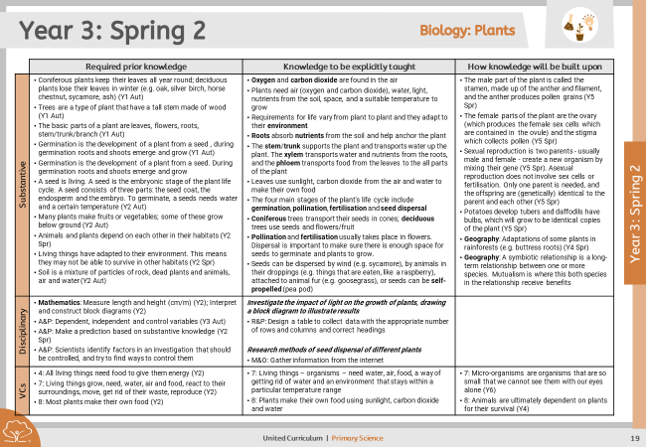
Vertical Concepts
The ‘big ideas of science education’ were first published by Wynne Harlen and a group of experts in science education in 2010.
These ideas set out key concepts that, when understood together, allow pupils to understand the world around them.
The ideas are expressed in the form of narrative descriptions that builds the understanding of key ideas from primary to secondary education. They cannot be understood in single units or lessons; we need to build concepts by attending to them in small steps within the curriculum.
Ten ideas are ideas of science, and span the disciplines of chemistry, biology and physics. Four are ideas about science, and contribute to pupils’ disciplinary understanding of how scientists work today.
Ideas of science
All material in the Universe is made of very small particles.
Objects can affect each other at a distance.
Changing the movement of an object requires a net force acting on it.
The total amount of energy in the Universe is always the same but energy can be transformed when things change or are made to happen.
The composition of Earth and its atmosphere and the processes occurring within them shape the Earth’s surface and its climate.
The solar system is a very small part of one of millions of galaxies in the Universe.
Organisms are organised on a cellular basis.
Organisms require a supply of energy and materials for which they are often dependent on or in competition with other organisms.
Genetic information is passed down from one generation of organisms to another.
The diversity of organisms, living and extinct, is the result of evolution.
Organisms are healthy when physically, mentally and socially well and free from disease. [This is additional to the original ten ideas and included as we felt it important].
Most units attend to at least one of these big ideas. The unit overview outlines the relevant building blocks that pupils will learn in each unit, and how the idea is developed in previous and subsequent units or at KS3-4.

Slide 3

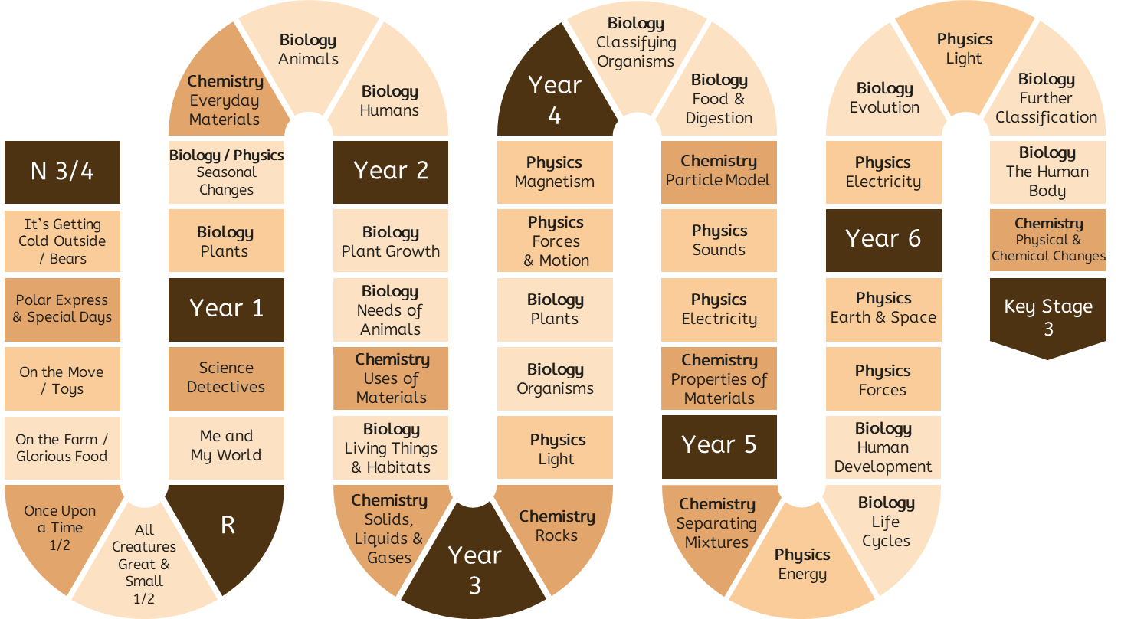
Progression in Vertical Concepts
Chemistry
1.
All material in the universe is made of very small particles.
If a material could be divided into smaller and smaller pieces, it would be found to be made of particles, which smaller than can be seen even with a microscope. These particles are not in a material; they are the material.
The particles of a substance are arranged differently when it is solid, liquid or gas.
Objects have a purpose and are made of different materials.
Properties of materials can be physical (such as hardness) or chemical (such as toxicity).
The same thing (water) can look different when it is hot or cold (ice).
A chemical change is where a new substance – that is made of a different type of particle – is formed.
The smallest piece of a material is called an atom. All materials, anywhere in the universe, living and non-­‐living, are made of a very large numbers of these basic ‘building blocks’, of which there are about 100 different kinds.
All the ‘stuff’ encountered in everyday life, including air, water and different kinds of solid substances, is called matter.
Different materials are recognisable by their properties.
Materials have different properties, which make them suitable for specific purposes.
Matter can exist in three different states: as solids, liquids and gases.
The amount and type of substance does not change when the matter changes state.
A pure substance is one that contains only one type of particle.
A mixture is created when two or more substances are mixed. The two types of particle are mixed together, but the particles themselves stay the same.

Slide 4

Progression in Vertical Concepts
Physics
2.
Objects can affect each other at a distance.
3. Forces act in pairs. Forces acting against each other are opposing.
If opposing forces equal, they are balanced, and the object’s motion will stay the same; this includes staying stationary. If opposing forces are unequal, they are unbalanced will change an object’s speed, direction or shape.
Friction is a force that will slow an object down.
2. The non-contact force of magnetism mean magnets can attract or repel other magnets and attract objects made of magnetic materials.
3. Friction is an example of a contact force.
2. Sound comes from objects that vibrate and can be detected at a distance from the source, because the air or other material around is made to vibrate. Sounds are heard when the vibrations in the air reach our ears.
3.
Changing the movement of an object requires a net force to be acting on it.
2. There is attraction and repulsion between objects that are electrically charged. Visible light and other forms of radiation can travel through any empty space.
3. How quickly an object’s motion is changed depends on the force acting and the object’s mass. The greater the mass of the object, the longer it takes to speed it up or slow it down (inertia).
2. Magnets can attract or repel other magnets.
Magnets attract magnetic objects.
3. We can push and pull objects to make them move.
3. The downward force of gravity on an object on the Moon is less than that on Earth because the Moon has less mass on Earth.
2. The non-contact force of gravity pulls objects towards the centre of the Earth.
3. There is gravitational force between all objects, but it is only felt when one or more of the objects has a very large mass. The greater the mass, the greater the gravitational force.
Objects on Earth are pulled to the centre of the Earth because the Earth’s mass and therefore gravitational force is much larger than that of the objects.
3. We can move or change the shape of objects by pushing and pulling: by squashing, bending, twisting or stretching the materials.
2. Objects can affect other objects even when they are not in contact with them. Light reaches our eyes, even though the light source may be far away.

Slide 5
Progression in Vertical Concepts
Physics
4.
The total amount of energy in the Universe is always the same, but energy can be transformed when things change or are made to happen.
4. In most plants, sunlight, carbon dioxide and water are used to make food in the leaves.
4. The arrows in a food web show where energy is being transferred from and to.
4. Energy resources can be renewable (such as wind, solar, geothermal and hydrological) or non-renewable (such as fossil fuels).
6. Daytime is when the Earth is facing the Sun; nighttime is when the Earth is facing away from the Sun.
4. All organisms respire.
4. Objects have energy because of their chemical composition, their movement, their temperature, their position in a gravitational or other field, or because of compression or distortion of an elastic material.
6. The tilt of the Earth’s axis gives rise to seasons.
The movements of galaxies suggest that the Universe is expanding from a past state called the ‘big bang’, towards a future that is still unclear.
6.
Our solar system is a very small part of one of millions of galaxies in our universe.
4. We have to push or pull objects to make them move; they do not move on their own.
6. Naming the Sun, Earth and Moon.
6. Our Sun is one of many stars that make up the Universe.
The distances between us and the bodies in solar system is huge, and even bigger in the Universe.
4. All living things need food to give them energy (and other things).
All food chains start with a producer (a living thing that makes its own food).
The arrows in a food chain show where energy is being transferred from and to.
6. The Sun emits light, some of which reaches Earth. The Moon reflects light from the Sun.
4. A cell in a complete circuit can make a bulb light or buzzer sound. This will not happen without a cell.
4. Many processes and phenomena are explained in terms of energy exchanges.
Energy cannot be created or destroyed. When energy is transferred from one object to others, the total amount of energy in the universe remains the same; the amount that one object loses is the same as the other objects gain.
Two examples of energy stores are thermal stores and chemical stores of energy.
Energy resources – but not energy – can be depleted.

Slide 6


Progression in Vertical Concepts
Earth Science & Geology
5 (A)
The composition of the Earth and its atmosphere and the processes occurring within them shape the Earth’s surface and its climate.
Geography: Features of hot deserts include rocks, sand dunes and oases. Features of cold deserts include mountains and ice sheets.
Rivers travel from highland areas to lowland areas. Physical features around rivers include valleys, mountains, hills and vegetation.
Geography: Use of fossil fuels to create plastics, and the effects this can have on the Earth.
Some plants grow in soil.
Geography: Formation of volcanoes and mountains at different types of plate boundaries. Movement of tectonic plates as caused by convection currents.
Radioactive decay of material inside the Earth since it was formed is its internal source of energy. Understanding the use of Earth’s energy resources in terms of energy stores and transfers.
Describing the natural things in our local area.
Geography: We live on the Earth. Physical features occur in nature and include river, forest, soil and hill.
Coastal areas are areas of land that are near the sea. Features in coastal areas include beach, cliff, sea and ocean.
Geography: Examples of natural resources include wood, food, water and fossil fuels. Fossil fuels are materials made from fossils over millions of years, like coal and oil. Humans use these to run cars and electrical items.
Natural resources are unevenly distributed across the world and can be renewable or non-renewable (finite).
The upper course of a river is in high, mountains ground and the river is narrow and fast flowing. The lower course of a river is in low, flat ground and the river is wide and slow flowing. The middle course is between the two. Rivers erode, transport and deposit to form waterfalls, meanders and floodplains.
Geographical features include beach, hill, forest, sea and river.
Rocks are formed when placed under pressure.
Much of the solid surface of the Earth is covered in soil, which is a mixture of pieces of rock of various sizes and the remains of organisms. Some soil also contains air, water and some nutrients.
There are three main kinds of rock: igneous, sedimentary and metamorphic, which each have different composition and properties.
Geography: There are several mountain ranges in the UK.
The Earth has four layers. Its upper layer of tectonic plates move.
Shield and composite volcanoes can form at plate boundaries, which produce lava, pyroclastic flows and lahars.
Soil is rich with nutrients around volcanoes.

Slide 7
Progression in Vertical Concepts
Environmental Science
Geography: The layer of air around the Earth is called the atmosphere.
Atmospheric circulation causes some areas on Earth to have higher levels of precipitation than others.
Tropical rainforests are places where there is lots of precipitation.
5 (B)
The composition of the Earth and its atmosphere and the processes occurring within them shape the Earth’s surface and its climate.
Geography: The weather is short-term. Climate is long-term summary of the weather conditions.
Precipitation is the fall of water as rain, sleet, snow or hail.
Deserts are places where there is very little precipitation.
The water cycle involves evaporation of water from oceans and condensation of water, which falls as precipitation.
The weather can change rapidly. The four different seasons have different weather patterns.
Geography: Mitigation and adaptation are ways that humans can reduce and live with the effects of climate change.
Types of weather include sunny, rainy, windy, and snowy.
Geography: Weather is determined by conditions of the air. The pressure, temperature, direction and speed of the movement and the amount of water vapour in the air combine to create weather.
Understanding convection currents in terms of pressure and particles.
The air is all around us on Earth. Air has oxygen in it.
We experience different types of weather in different seasons (focus on spring and winter).
There is less and less air further away from the Earth’s surface; space is a vacuum.
Global warming describes the increase in Earth’s average temperatures.
Air has carbon dioxide in it.
Air is a mixture of lots of different gases, including oxygen and carbon dioxide.
Geography: The amount of water on Earth is constant. Most is saltwater stored in oceans, and most freshwater is stored as ice or underground.
Water cycle: Evaporation from the air and transpiration from plants means that water vapour rises in the air. It condenses to form clouds and precipitation occurs when the clouds get heavy. Surface runoff is the flow of water overground; throughflow is the flow of water underground.
Climate zones share long-term weather patterns. There are six main climate zones: polar, temperate, arid, tropical, Mediterranean and mountains.
Biomes are areas of the world that, because of similar climates, have similar landscapes, flora and fauna. The major biomes of the world are tundra, tropical rainforests, coral reefs, temperate forests and hot deserts.
The natural greenhouse effect, the enhanced greenhouse effect, global warming and resulting climate change.
The increase in frequency of extreme weather events like heatwaves and drought as a result of climate change.

Slide 8

Progression in Vertical Concepts
Biology
7.
Organisms are organised on a cellular basis.
8. Living things, including humans, react to their surroundings with their senses.
8. Plants make their own food using sunlight, carbon dioxide and water.
8. The feeding relationships between organisms can be represented as food chains and food webs. They show where the energy is being transferred from and to.
7. Plants are organised with roots, stem, leaves and flowers.
7. Micro-organisms are organisms that are so small that we cannot see them with our eyes alone.
8. There is a wide variety of living things on Earth, including plants and animals.
8.
Organisms require a supply of energy and materials for which they are often dependent or in competition with other organisms.
7. Respiration takes places in cells.
8. Living things move, reproduce, are sensitive to their surroundings, grow, respire, excrete, and need nutrition (MRS GREN).
8. All living things need food, oxygen, water and certain temperature conditions.
7. All organisms are made of one or more cells, which can only be seen through a microscope. All the basic functions of life – growth, reproduction, extracting energy from food – are the results of what happens inside cells. Cells are often aggregated into tissues, tissues into organs, and organs into organ systems.
8. Decomposers are essential (alongside producers and consumers) for a stable ecosystem.
8. Most plants make their own food. Animals’ food comes from eating plants (herbivores) or by eating animals (carnivores), which have eaten plants or other animals. These relationships can be represented in a food chain.
Plants and animals are often dependent on each other.
Organisms are adapted to their environment. If conditions in a habitat change, organisms may not be able to survive.
Organisms move, reproduce, are sensitive to their surroundings, grow, need oxygen, get rid of their waste, and need nutrition (MRS GOWN).
7. Humans are organised with organs like hearts and lungs, which do particular jobs. The skeleton and muscles allow the body to move.
8. Energy is transferred to the Earth by light. When making their own food, plants transfer some of this energy to their chemical store. As other organisms eat these producers, some energy in this chemical energy store is transferred.
7. A cell is the smallest building block of living things. All organisms are made of cells.
There are lots of different types of cell (e.g. sex cells), which each have different purposes.

Slide 9
Progression in Vertical Concepts
Biology
10. To help scientists make sense of the diversity of organisms, they are classified into different groups. Each group has similar features.
9. When a plant reproduces, it goes through stages of pollination, fertilisation and seed dispersal. The seed will then germinate and grow into a plant.
9. A species is a group of one type of organism. Individuals in this group can breed with each other to produce offspring that can go on to reproduce.
10. Variation exists within species, caused by genetic and environmental factors.
Living things are found in certain environments because they have the features that enable them to survive there. This adaptation to their environment has come about because of the small differences that occur during reproduction, resulting in some individuals being better suited to the environment than others. In the competition for materials and food, those that are better adapted will survive and are more likely to pass on their adapted feature to their offspring. Fossils are evidence of evolution.
9.
Genetic information is passed down from
one generation of organisms to another.
10. There are lots of types of animal, and some types can be grouped as amphibians, birds, fish, mammals and reptiles.
10.
Diversity of organisms, living and extinct, is the result of evolution.
9. Plants and animals reproduce (have offspring).
9. Young animals grow into adult animals. The young look similar, but not the same, as the adults.
9. In a human body, most cells contain 23 pairs of chromosomes. These provide information that is needed to make more cells in growth and reproduction.
10. The natural selection of organisms has been going since the first form of life appeared on Earth 3.5 billion years ago. Multi-cellular organisms evolved around 2 billion years ago.
10. There are many different kinds of plants and animals in the world today.
9. When there are no living individuals of a species to reproduce, the species is extinct.
10. We know about extinct and dead species from fossils. These are the preserved remains (or traces) of organisms that lived many years ago.
9. An organism's genome is the information that controls how that individual organism will develop.
In sexual reproduction, two parents contribute to the formation of offspring. They each pass down half their genome through specialised cells called sex cells. The two halves are combined during fertilisation. While it inherits genetic information from both parents, the offspring's genome is distinct, which means the offspring is not identical to a parent.
Asexual reproduction involves only one parent. In this process, the offspring's genome is an exact copy of the parent's genome. The offspring is identical to the parent.
9. A species is a group of living things of the same type.
10. Biodiversity describes all the different living things in an area.
Living things are adapted to their environments. If the environment changes, the organisms may no longer be adapted and may struggle to survive.

Slide 10
Progression in Vertical Concepts
Biology
11. Visual impairments include long and short sightedness, colour vision deficiency, and blindness. Some of these can be corrected, and some people with visual impairments will use Braille, magnifying devices, canes and/or guide dogs.
11.
Organisms are healthy when physically, mentally and socially well and free from disease.
11. Humans have five senses. Some people have impairments, like visual and hearing impairments.
11. Bacteria are tiny living things. Some are useful for humans, and some can cause diseases. Bacteria can cause tooth decay.
11. Humans with hearing loss may use closed captions, hearing aids and/or sign language.
11. Being healthy means we are in a state of physical, mental and social well being and are free from disease. Some drugs can help us and some can harm us (particularly in the wrong quantities).
11. Humans need to practise good hygiene, like brushing teeth and washing hands.
11. The biological causes and effects of diseases (e.g. coeliac disease and emphysema), exercise, lifestyles (e.g. vaping) and deficiencies on the body. Pathogens, their transmission and how transmission can be prevented.
11. Healthy development includes cognitive, physical, social and emotional development. Most of this happens during infancy and childhood. Ageing happens naturally, and can be sped up by environmental factors like smoking.
Some adults are unable to become pregnant. IVF and other treatments can be used.
11. Humans need to exercise, practise good hygiene and eat a healthy and balanced diet to stay healthy. Their diet should be high in fruits and vegetables and low in fats, sugar and salt.
11. A balanced diet includes the right proportions of the main food groups of carbohydrates (starch and sugars), proteins, fats, fibre, vitamins and minerals.
Animals, including humans, may get diseases (like scurvy) if they are deficient in vitamins and minerals.
11. Some substances are toxic; this means they can be poisonous. Humans and other organisms need to avoid these to stay healthy.

Slide 11
Big ideas of science
Vertical Concepts
 | 1. All material in the universe is made of very small particles. | 2. Objects can affect each other at a distance.
EYFS | The same thing (water) can look different when it is hot or cold (ice). | Magnets can attract or repel other magnets. Magnets attract objects made of magnetic materials.
Y1 | Objects have a purpose and are made of different materials.
Y2 | All the ‘stuff’ encountered in everyday life, including air, water and different kinds of solid substances, is called matter. Different materials are recognisable by their properties. Materials have different properties, which make them suitable for specific purposes. Matter can exist in three different states: as solids, liquids and gases. The amount and type of substance does not change when the matter changes state.
Y3 |  | Objects can affect other objects even when they are not in contact with them. Light reaches our eyes, even though the light source may be far away. The non-contact force of magnetism mean magnets can attract or repel other magnets and attract objects made of magnetic materials.
Y4 | If a material could be divided into smaller and smaller pieces, it would be found to be made of particles, which smaller than can be seen even with a microscope. These particles are not in a material; they are the material. The particles of a substance are arranged differently when it is solid, liquid or gas. Properties of materials can be physical (such as hardness) or chemical (such as toxicity). | Sound comes from objects that vibrate and can be detected at a distance from the source, because the air or other material around is made to vibrate. Sounds are heard when the vibrations in the air reach our ears.
Y5 | A pure substance is one that contains only one type of particle. A mixture is created when two or more substances are mixed. The two types of particle are mixed together, but the particles themselves stay the same. | The non-contact force of gravity pulls objects towards the centre of the Earth.
Y6 | A chemical change is where a new substance – that is made of a different type of particle – is formed.
KS3 | The smallest piece of a material is called an atom. All materials, anywhere in the universe, living and non-­‐living, are made of a very large numbers of these basic ‘building blocks’, of which there are about 100 different kinds. | There is attraction and repulsion between objects that are electrically charged. Visible light and other forms of radiation can travel through any empty space.

Slide 12
Big ideas of science
Vertical Concepts
 | 3. Changing the movement of an object requires a net force to be acting on it. | 4. The total amount of energy in the Universe is always the same, but energy can be transformed when things change or are made to happen. | 6. Our solar system is a very small part of one of millions of galaxies in our universe.
EYFS | We can push and pull objects to make them move. Magnets can be used to make other magnets and magnetic materials move. | We have to push or pull objects to make them move; they do not move on their own. | Naming the Sun, Earth and Moon.
Y1 |  |  | Daytime is when the Earth is facing the Sun; nighttime is when the Earth is facing away from the Sun.
Y2 | We can move or change the shape of objects by pushing and pulling: by squashing, bending, twisting or stretching the materials. | All living things need food to give them energy. All food chains start with a producer (a living thing that makes its own food). The arrows in a food chain show where energy is being transferred from and to.
Y3 | Forces act in pairs. Forces acting against each other are opposing. If opposing forces equal, they are balanced, and the object’s motion will stay the same; this includes staying stationary. If opposing forces are unequal, they are unbalanced will change an object’s speed, direction or shape. Friction is a force that will slow an object down. Friction is an example of a contact force. |  | The Sun emits light, some of which reaches Earth. The Moon reflects light from the Sun.
Y4 |  | The arrows in a food web show where energy is being transferred from and to. A cell in a complete circuit can make a bulb light or buzzer sound. This will not happen without a cell.
Y5 | There is gravitational force between all objects, but it is only felt when one or more of the objects has a very large mass. The greater the mass, the greater the gravitational force. Objects on Earth are pulled to the centre of the Earth because the Earth’s mass and therefore gravitational force is much larger than that of the objects. The downward force of gravity on an object on the Moon is less than that on Earth because the Moon has less mass on Earth. | Many processes and phenomena are explained in terms of energy exchanges. Energy cannot be created or destroyed. When energy is transferred from one object to others, the total amount of energy in the universe remains the same; the amount that one object loses is the same as the other objects gain. Two examples of energy stores are thermal stores and chemical stores of energy. Energy resources – but not energy – can be depleted. | Our Sun is one of many stars that make up the Universe. The distances between us and the bodies in solar system is huge, and even bigger in the Universe.
Y6 |  | Energy resources can be renewable (such as wind, solar, geothermal and hydrological) or non-renewable (such as fossil fuels). All organisms respire.
KS3 | How quickly an object’s motion is changed depends on the force acting and the object’s mass. The greater the mass of the object, the longer it takes to speed it up or slow it down (inertia). | Objects have energy because of their chemical composition, their movement, their temperature, their position in a gravitational or other field, or because of compression or distortion of an elastic material. | The movements of galaxies suggest that the Universe is expanding from a past state called the ‘big bang’, towards a future that is still unclear.

Slide 13
Big ideas of science
Vertical Concepts
 | 5. The composition of the Earth and its atmosphere and the processes occurring within them shape the Earth’s surface and its climate.
 | A: Earth Science
EYFS | Describing the natural things in our local area. Geographical features include beach, hill, forest, sea and river.
Y1 | Geography: We live on the Earth. Geography: Physical features occur in nature and include river, forest, soil and hill. Geography: Coastal areas are areas of land that are near the sea. Features in coastal areas include beach, cliff, sea and ocean. Science: Some plants grow in soil.
Y2 | Geography: Features of hot deserts include rocks, sand dunes and oases. Features of cold deserts include mountains and ice sheets. Geography: Rivers travel from highland areas to lowland areas. Physical features around rivers include valleys, mountains, hills and vegetation.
Y3 | Science: Rocks are formed when placed under pressure. Science: Much of the solid surface of the Earth is covered in soil, which is a mixture of pieces of rock of various sizes and the remains of organisms. Some soil also contains air, water and some nutrients. Science: There are three main kinds of rock, igneous, sedimentary and metamorphic, with different composition and properties. Geography: There are several mountain ranges in the UK. Geography: The Earth has four layers. Its upper layer of tectonic plates move. Geography: Shield and composite volcanoes can form at plate boundaries, which produce lava, pyroclastic flows and lahars. Geography: Soil is rich with nutrients around volcanoes.
Y4
Y5 | Geography: Examples of natural resources include wood, food, water and fossil fuels. Fossil fuels are materials made from fossils over millions of years, like coal and oil. Humans use these to run cars and electrical items. Geography: Natural resources are unevenly distributed across the world and can be renewable or non-renewable (finite). Geography: The upper course of a river is in high, mountains ground and the river is narrow and fast flowing. The lower course of a river is in low, flat ground and the river is wide and slow flowing. The middle course is between the two. Geography: Rivers erode, transport and deposit to form waterfalls, meanders and floodplains.
Y6 | Geography: Use of fossil fuels to create plastics, and the effects this can have on the Earth.
KS3 | Geography: Formation of volcanoes and mountains at different types of plate boundaries. Movement of tectonic plates as caused by convection currents. Science: Radioactive decay of material inside the Earth since it was formed is its internal source of energy. Understanding the use of Earth’s energy resources in terms of energy stores and transfers.

Slide 14
Big ideas of science
Vertical Concepts
 | 5. The composition of the Earth and its atmosphere and the processes occurring within them shape the Earth’s surface and its climate.
 | B: Environmental Science
EYFS | We experience different types of weather in different seasons (focus on spring and winter). Types of weather include sunny, rainy, windy, and snowy.
Y1 | Science: The weather can change rapidly. The four different seasons have different weather patterns.
Y2 | Geography: The weather is short-term. Climate is long-term summary of the weather conditions. Geography: Precipitation is the fall of water as rain, sleet, snow or hail. Geography: Deserts are places where there is very little precipitation. Science: There is air all around us on Earth. Air has oxygen in it. Science: Global warming describes the increase in average temperatures on Earth.
Y3 | Science: Air has carbon dioxide in it.
Y4 | Science: The water cycle involves evaporation of water from oceans and condensation of water, which falls as precipitation. Geography: The layer of air around the Earth is called the atmosphere. Geography: Atmospheric circulation causes some areas on Earth to have higher levels of precipitation than others. Geography: Tropical rainforests are places where there is lots of precipitation.
Y5 | Science: Air is a mixture of lots of different gases, including oxygen and carbon dioxide. Geography: The amount of water on Earth is constant. Most is saltwater stored in oceans, and most freshwater is stored as ice or underground. Geography: Water cycle: Evaporation from the air and transpiration from trees means that water vapour rises in the air. It condenses to form clouds and precipitation occurs when the clouds get heavy. Surface runoff is the flow of water overground; throughflow is the flow of water underground. Geography: Climate zones share long-term weather patterns. There are six main climate zones: polar, temperate, arid, tropical, Mediterranean and mountains. Geography: Biomes are areas of the world that, because of similar climates, have similar landscapes, flora and fauna. The major biomes of the world are tundra, tropical rainforests, coral reefs, temperate forests and hot deserts. Science: There is less and less air further away from the Earth’s surface. Geography: The natural greenhouse effect, the enhanced greenhouse effect, global warming and resulting climate change. Geography: The increase in frequency of extreme weather events like heatwaves and drought as a result of climate change.
Y6 | Geography: Mitigation and adaptation are ways that humans can reduce and live with the effects of climate change.
KS3 | Geography: Weather is determined by conditions of the air. The pressure, temperature, direction and speed of the movement and the amount of water vapour in the air combine to create weather. Science: Understanding convection currents in terms of pressure and particles.

Slide 15
Big ideas of science
Vertical Concepts
 | 7. Organisms are organised on a cellular basis. | 8. Organisms require a supply of energy and materials for which they are often dependent on or in competition with other organisms.
EYFS |  | There is a wide variety of living things on Earth, including plants and animals.
Y1 | Plants are organised with roots, stem, leaves and flowers. | Living things, including humans, react to their surroundings with their senses.
Y2 |  | All living things need food, oxygen, water and certain temperature conditions. Most plants make their own food. Animals’ food comes from eating plants (herbivores) or by eating animals (carnivores), which have eaten plants or other animals. These relationships can be represented in a food chain. Plants and animals are often dependent on each other. Organisms are adapted to their environment. If conditions in a habitat change, organisms may not be able to survive. Organisms move, reproduce, are sensitive to their surroundings, grow, need oxygen, get rid of their waste, and need nutrition (MRS GOWN).
Y3 | Humans are organised with organs like hearts and lungs, which do particular jobs. The skeleton and muscles allow the body to move. | Plants make their own food using sunlight, carbon dioxide and water.
Y4 |  | The feeding relationships between organisms can be represented as food chains and food webs. They show where the energy is being transferred from and to.
Y5 | A cell is the smallest building block of living things. All organisms are made of cells. There are lots of different types of cell (e.g. sex cells), which each have different purposes. | Energy is transferred to the Earth by light. When making their own food, plants transfer some of this energy to their chemical store. As other organisms eat these producers, some energy in this chemical energy store is transferred.
Y6 | Micro-organisms are organisms that are so small that we cannot see them with our eyes alone. Respiration takes places in cells. | Living things move, reproduce, are sensitive to their surroundings, grow, respire, excrete, and need nutrition (MRS GREN).
KS3 | All organisms are made of one or more cells, which can only be seen through a microscope. All the basic functions of life – growth, reproduction, extracting energy from food – are the results of what happens inside cells. Cells are often aggregated into tissues, tissues into organs, and organs into organ systems. | Decomposers are essential (alongside producers and consumers) for a stable ecosystem.

Slide 16
Big ideas of science
Vertical Concepts
 | 9. Genetic information is passed down from one generation of organisms to another. | 10. Diversity of organisms, living and extinct, is the result of evolution.
EYFS | Young animals grow into adult animals. The young look similar, but not the same, as the adults. | There are many different kinds of plants and animals in the world today.
Y1 |  | There are lots of types of animal, and some types can be grouped as amphibians, birds, fish, mammals and reptiles.
Y2 | Plants and animals reproduce (have offspring). A species is a group of living things of the same type. | Biodiversity describes all the different living things in an area. Living things are adapted to their environments. If the environment changes, the organisms may no longer be adapted and may struggle to survive.
Y3 | When there are no living individuals of a species to reproduce, the species is extinct. When a plant reproduces, it goes through stages of pollination, fertilisation and seed dispersal. The seed will then germinate and grow into a plant. | We know about extinct and dead species from fossils. These are the preserved remains (or traces) of organisms that lived many years ago. To help scientists make sense of the diversity of organisms, they are classified into different groups. Each group has similar features.
Y4 | A species is a group of one type of organism. Individuals in this group can breed with each other to produce offspring that can go on to reproduce. | A species is a group of one type of organism. Individuals in this group can breed with each other to produce offspring that can go on to reproduce.
Y5 | An organism's genome is the information that controls how that individual organism will develop. In sexual reproduction, two parents contribute to the formation of offspring. They each pass down half their genome through specialised cells called sex cells. The two halves are combined during fertilisation. While it inherits genetic information from both parents, the offspring's genome is distinct, which means the offspring is not identical to a parent. Asexual reproduction involves only one parent. In this process, the offspring's genome is an exact copy of the parent's genome. The offspring is identical to the parent. | Although organisms of the same species are very similar, there is variation within them.
Y6 |  | Variation exists within species, caused by genetic and environmental factors. Living things are found in certain environments because they have the features that enable them to survive there. This adaptation to their environment has come about because of the small differences that occur during reproduction, resulting in some individuals being better suited to the environment than others. In the competition for materials and food, those that are better adapted will survive and are more likely to pass on their adapted feature to their offspring. Fossils are evidence of evolution.
KS3 | In a human body, most cells contain 23 pairs of chromosomes. These provide information that is needed to make more cells in growth and reproduction. | The natural selection of organisms has been going since the first form of life appeared on Earth 3.5 billion years ago. Multi-cellular organisms evolved around 2 billion years ago.

Slide 17
Big ideas of science
Vertical Concepts
 | 11: Organisms are healthy when physically, mentally and socially well and free from disease.
EYFS | Humans need to practise good hygiene, like brushing teeth and washing hands.
Y1 | Humans have five senses. Some people have impairments, like visual and hearing impairments.
Y2 | Humans need to exercise, practise good hygiene and eat a healthy and balanced diet to stay healthy. Their diet should be high in fruits and vegetables and low in fats, sugar and salt.
Y3 | A balanced diet includes the right proportions of the main food groups of carbohydrates (starch and sugars), proteins, fats, fibre, vitamins and minerals. Animals, including humans, may get diseases (like scurvy) if they are deficient in vitamins and minerals.
Y4 | Bacteria are tiny living things. Some are useful for humans, and some can cause diseases. Bacteria can cause tooth decay. Humans with hearing loss may use closed captions, hearing aids and/or sign language. Some substances are toxic; this means they can be poisonous. Humans and other organisms need to avoid these to stay healthy.
Y5 | Healthy development includes cognitive, physical, social and emotional development. Most of this happens during infancy and childhood. Ageing happens naturally, and can be sped up by environmental factors like smoking. Some adults are unable to become pregnant. IVF and other treatments can be used.
Y6 | Visual impairments include long and short sightedness, colour vision deficiency, and blindness. Some of these can be corrected, and some people with visual impairments will use Braille, magnifying devices, canes and/or guide dogs. Being healthy means we are in a state of physical, mental and social well being and are free from disease. Some drugs can help us and some can harm us (particularly in the wrong quantities).
KS3 | Considering the biological causes and effects of diseases (e.g. coeliac disease and emphysema), exercise, lifestyles (e.g. vaping) and deficiencies on the body. Staying healthy during pregnancy. Pathogens, how they are transmitted and how transmission can be prevented (first line of defence).

Slide 18
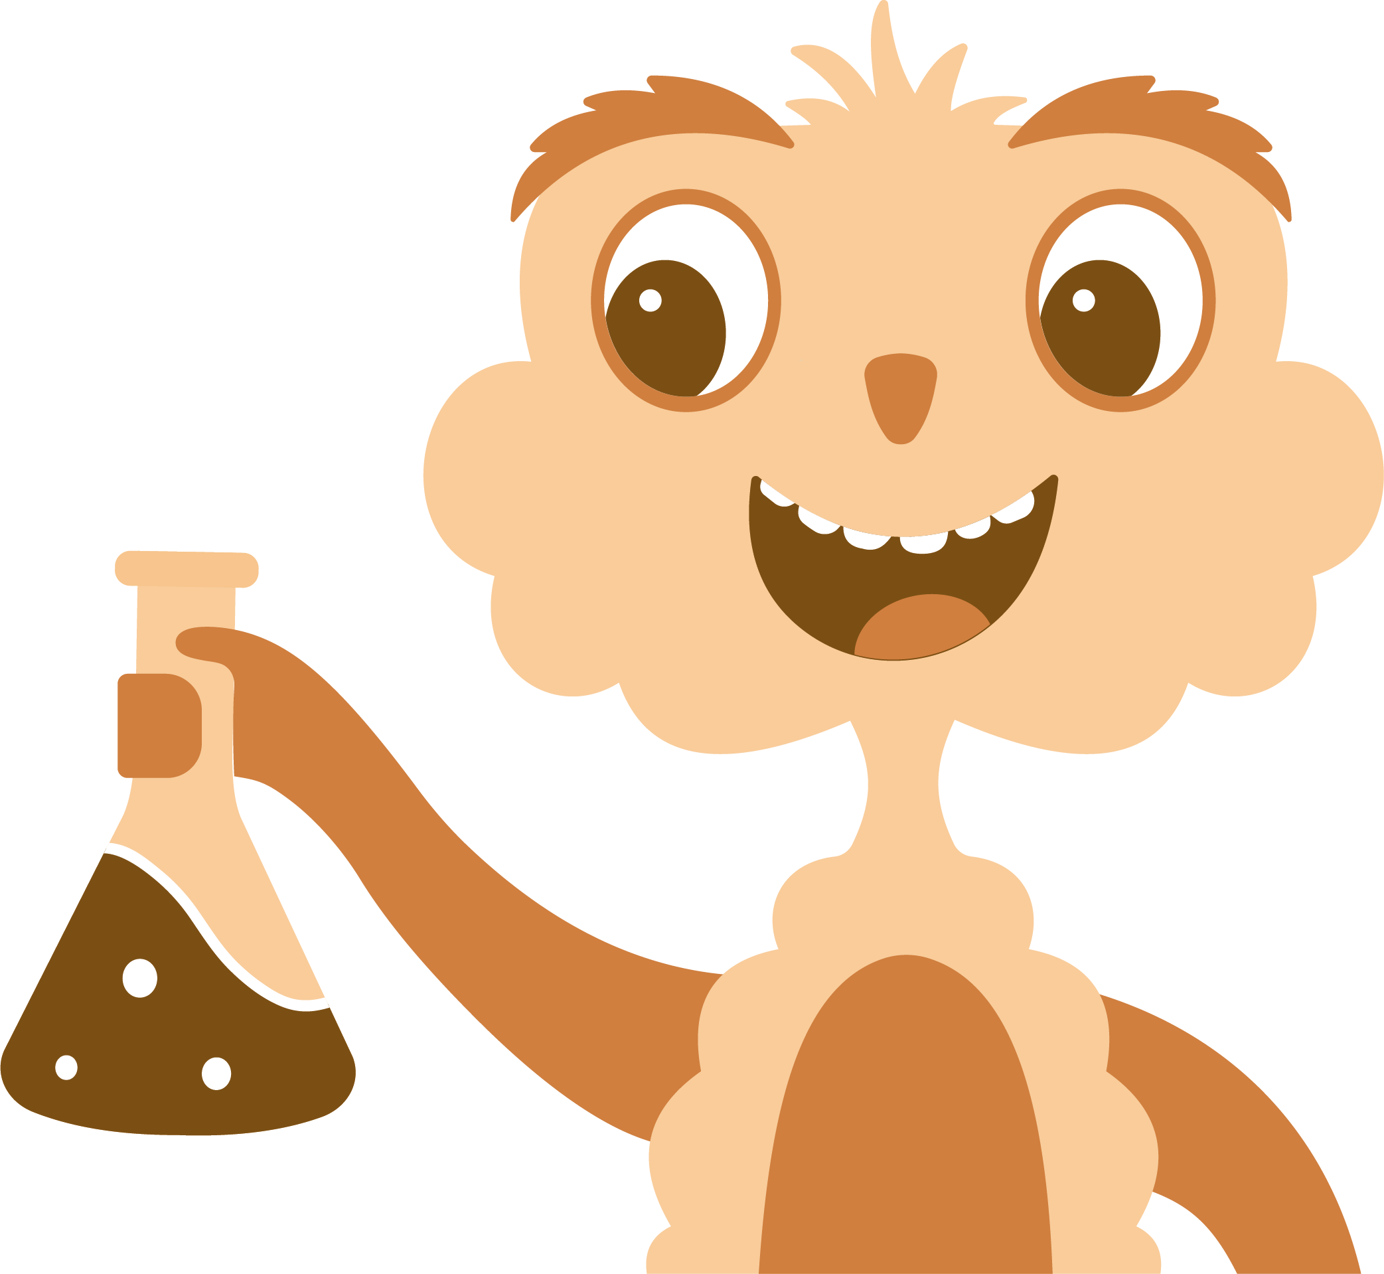
Big ideas about science
Vertical concepts
Ideas about science
Ideas about science relate to disciplinary knowledge and working scientifically. They are best taught with explicit reference in appropriate units. Not all the ideas are relevant to every unit (for example, the idea that ‘theories and models fit the facts of the time’ is better considered through the topics of classification or the solar system than, for example, magnetism). The most relevant ideas are therefore explicitly referenced at an appropriate level in the unit overviews and lesson slides:
Science assumes that for every effect there is one or more causes
Scientific explanations, theories, and models are those that best fit the facts known at a particular time
The knowledge produced by science is used in some technologies to create products to serve human ends
Applications of science often have ethical, social and economic consequences

Slide 19
Disciplinary knowledge (KS1)
The below tables outlines where disciplinary knowledge – the working scientifically elements – is first taught and deliberately practised in KS1 or KS2. The curriculum has been sequenced so that the content is also reviewed in subsequent units (and may also be reviewed in other subject areas like geography and history), but to keep the table readable, we have only set out where it is first taught. The Mathematics Programmes of Study have been considered so that pupils never need to apply mathematical skills (e.g. calculating mean, rounding to an appropriate degree, constructing graphs) until they have first been taught in mathematics lessons.
 | Scientific Attitudes & Planning (A&P) | Measuring & Observing (M&O) | Recording & Presenting (R&P) | Analysing & Evaluating (A&E)
EYFS | Make predictions about what might happen when I try something. | Measure/observe using senses. Observe using a magnifying glass safely. | Use hoops to classify objects based on simple criteria. | Notice patterns in the world around me.
Y1 | Scientists look for patterns in the world around them. Scientists group objects or living things based on their properties. Scientists conduct secondary research to learn from what other scientists have already learned. | Gather information from text/ books/ images. | Record numerical or descriptive observations in a table. Draw a diagram, a simple scientific drawing that explains or informs. Use a table to classify items based on properties. Use a Carroll diagram to classify items based on properties. Use a Venn diagram to classify items into two or three sets based on properties. | Make simple statements about the results of an enquiry.
Y2 | It is important that we keep as much as we can the same, apart from the one thing we measure and the one thing we change. Make a prediction based on substantive knowledge. There are four main stages of enquiry (A&P, M&O, R&P, A&E). Scientists identify potential hazards in their experiments and plan ways to reduce them. | Make systematic observations of an object. | Use a pair of axes to classify items based on the extent it displays two properties. | Ask further questions that could be explored to extend findings.

Slide 20
Disciplinary knowledge (KS2)
 | Scientific Attitudes & Planning (A&P) | Measuring & Observing (M&O) | Recording & Presenting (R&P) | Analysing & Evaluating (A&E)
Y3 | Select most appropriate equipment to measure (the variables) that will give you the best chance of an accurate result. A dependent variable is what you measure; an independent variable is what you change; controlled variables are things that stay the same. Scientists identify factors in an investigation that should be controlled, and try to find ways to control them. Write an appropriate method. Science is studied as three disciplines: biology (study of organisms), chemistry (study of materials) and physics (study of energy). | Gather information from the internet. Anomalous results should be discarded and rerecorded. Data is repeatable if the same person repeats the investigation and gets the same results; data is reproducible if the investigation is repeated by a different person and the results are the same. Taking multiple readings allows you to see if your data is repeatable, and helps identify outliers. | Design a table to collect data with the appropriate number of rows and columns and correct headings. | Draw conclusions (e.g. 'the greater the… , the greater the…’). Use scientific understanding to explain their findings. Suggest ways to improve practical procedures to obtain more accurate measurements. Use findings of investigation to make further predictions.
Y4 | Set a hypothesis to test. Draw diagram of the investigation. Scientists use models to help explain their ideas. | Gather information using a data logger (e.g. sound meter app; heart rate app). | Use a classification key to identify an object. Draw a dichotomous classification key to help others identify an object. Drawings can be labelled and annotated Present information orally using a prop or demonstration. Present information in a written format. Draw labelled and annotated diagrams. | Identify scientific evidence that has been used to support or refute ideas.
Y5 | Science is studied as three disciplines: biology (study of organisms), chemistry (study of properties of matter and how it interacts with energy) and physics (study of energy). Scientists look for patterns in data to try to identify correlations. | Measure force using a Newtonmeter. | Scatter graphs can help you decide if there is a relationship between two variables. (Geography: Interpret and construct climate graph). Line graphs can be used when data is continuous; bar charts can be used when data is discrete. | Make judgements on the accuracy of the data Some people may agree or disagree with the use of some scientific discoveries. Science is never 'complete' and scientists are always working to make models more accurate or to discover new explanations.
Y6 |  | Taking multiple readings allows you to see if your data is repeatable, helps identify outliers and allows a mean to be calculated. | Decide which graph is most appropriate for the enquiry. | Calculating the mean can be used as a method of analysing data.
KS3 | Evaluate risks. | Pay attention to objectivity and concern for accuracy, precision, repeatability and reproducibility. Use a wider range of apparatus and techniques Apply sampling techniques. Evaluate data, showing awareness of potential sources of random and systematic error. | Use a range of graph types to display data, including pie charts, scatter graphs and line graphs. | The difference between correlation and causation, and suggesting ways to test for both Understand that scientific methods and theories develop as earlier explanations are modified to take account of new evidence and ideas, together with the importance of publishing results and peer review.

